Slide 1
Multi-Tiered Architecture of data warehousing and data mining
Monitor
&
Integrator
OLAP Server
other
sources
Metadata
Analysis
Query
Reports
Data mining
Operational
DBs
Extract
Transform
Load
Integration
Refresh
Data
Warehouse
Serve
Data Marts
Data Sources
Data Storage
OLAP Engine
Front-End Tools
2008/1/9
1

Slide 2
What is XML?
EXtensible Markup Language (XML)
World Wide Web Consortium (W3C) recommendation Version 1.0 as of 10/02/1998.
Describes data, rather than instructing a system on how to process it.
Provides powerful capabilities for data integration and data-driven styling.
Introduces new processing paradigms and requires new ways of thinking about Web development.
A Meta-Markup Language, a set of rules for creating semantic tags used to describe data.
2008/1/9

Slide 3
XML is Extensible
The tags used to markup HTML documents and the structure of HTML documents are predefined.
The author of HTML documents can only use tags that are defined in the HTML standard.
XML allows the author to define his own tags and his own document structure.
2008/1/9

Slide 4
Benefits of using XML
It is structured.
Documents are easily committed to a persistence layer.
Platform independent, textual information.
An open standard.
Language independent.
DOM and SAX are open, language-independent set of interfaces.
It is Web enabled.
2008/1/9

Slide 5
Typical XML System
XML Document
(Content)
XML Parser
(Processor)
XML Application
XML DTD
(Rules)
XML Document (content)
XML Document Type Definition - DTD (structure definition; this is an operational part)
XML Parser (conformity checker)
XML Application (uses the output of the Parser to achieve your unique objectives)
2008/1/9

Slide 6
How XML can be used?
XML can keep data separated from your HTML document.
XML can also store data inside HTML documents (Data Islands).
XML can be used to exchange data.
XML can be used to store data.
2008/1/9

Slide 7
XML Syntax
An example XML document.
  <?xml version="1.0"?>
  <note>
  <to>Tan Siew Teng</to>
  <from>Lee Sim Wee</from>
  <heading>Reminder</heading>
  <body>Don't forget the Golf Championship this weekend!</body>
  </note>
2008/1/9

Slide 8
Example (cont’d)
The first line in the document: The XML declaration should always be included.
It defines the XML version of the document.
In this case the document conforms to the 1.0 specification of XML.
<?xml version="1.0"?>
The next line defines the first element of the document (the root element):
<note>
2008/1/9

Slide 9
Example (cont’d)
The next lines defines 4 child elements of the root (to, from, heading, and body):
  <to>Tan Siew Teng</to>
  <from>Lee Sim Wee</from>
  <heading>Reminder</heading>
  <body>Don't forget the Golf Championship this weekend!</body>
The last line defines the end of the root element:
</note>
2008/1/9

Slide 10
What is an XML element?
An XML element is made up of a start tag, an end tag, and data in between.
  <Sport>Golf</Sport>
The name of the element is enclosed by the less than and greater than characters, and these are called tags.
The start and end tags describe the data within the tags, which is considered the value of the element.
For example, the following XML element is a <player> element with the value “Tiger Wood.”
  <player>Tiger Wood</player>
2008/1/9

Slide 11
There are 3 types of tags
Start-Tag
  In the example <Sport> is the start tag. It defines type of the element and possible attribute specifications
    <Player firstname=“Wood" lastname=“Tiger">
End-Tag
  In the example </Sport> is the end tag. It identifies the type of element that tag is ending. Unlike start tag end tag cannot contain attribute specifications.
Empty Element Tag
  Like start tag this has attribute specifications but it does not need an end tag. Denotes that element is empty (does not have any other elements). Note the symbol for ending tag '/' before '> '
    <Player firstname=“Wood" lastname=“Tiger"/>
2008/1/9

Slide 12
XML elements must have a closing tag
In HTML some elements do not have to have a closing tag.
The following code is legal in HTML:
<p>This is a paragraph
<p>This is another paragraph
In XML all elements must have a closing tag like this:
<p>This is a paragraph</p>
<p>This is another paragraph</p>
2008/1/9

Slide 13
Rules for Naming Elements
XML names should start with a letter or the underscore character.
Rest of the name can contain letters, digits, dots, underscores or hyphens.
No spaces in names are allowed.
Names cannot start with 'xml' which is a reserved word.
2008/1/9

Slide 14
XML tags are case sensitive
XML tags are case sensitive. The tag <Message> is different from the tag <message>.
Opening and closing tags must therefore be written with the same case:
<message>This is correct</message>
<Message>This is incorrect</message>
2008/1/9

Slide 15
All XML elements must be properly nested
In HTML some elements can be improperly nested within each other like this:
<b><i>This text is bold and italic</b></i>
In XML all elements must be properly nested within each other like this
<b><i>This text is bold and italic</i></b>
2008/1/9

Slide 16
XML documents must have a root tag
Documents must contain a single tag pair to define the root element.
All other elements must be nested within the root element.
All elements can have sub (children) elements.
Sub elements must be in pairs and correctly nested within their parent element:
<root>
<child>
<subchild>
</subchild>
</child>
</root>
2008/1/9

Slide 17
XML Attributes
XML attributes are normally used to describe XML elements, or to provide additional information about elements.
An element can optionally contain one or more attributes. An attribute is a name-value pair separated by an equal sign (=).
Usually, or most common, attributes are used to provide information that is not a part of the content of the XML document.
Often the attribute data is more important to the XML parser than to the reader.
2008/1/9

Slide 18
XML Attributes (cont’d)
Attributes are always contained within the start tag of an element. Here are some examples:
  <Player firstname=“Wood" lastname=“Tiger“ />
    Player - Element Name
    Firstname - Attribute Name
    Wood - Attribute Value
HTML examples:
<img src="computer.gif">
<a href="demo.asp">
XML examples:
<file type="gif">
<person id="3344">
2008/1/9

Slide 19
Attribute values must always be quoted
XML elements can have attributes in name/value pairs just like in HTML.
An element can optionally contain one or more attributes.
In XML the attribute value must always be quoted.
An attribute is a name-value pair separated by an equal sign (=).
<CITY ZIP="01085">Westfield</CITY>
ZIP="01085" is an attribute of the <CITY> element.
2008/1/9

Slide 20
What is a Comment ?
Comments are informational help for the reader.
These are ignored by XML processors.
They are enclosed within "<!--" and "-->" tags.
  <!-- This is a comment -->
2008/1/9

Slide 21
What is a Processing Instruction ?
Processing Instructions provide a way to send instructions to computer programs or applications. They are enclosed within "<?" and "?>" tags.
  <? xml:stylesheet type="text/xsl" href="styler.xsl" ?>
  xml:stylesheet - Application name
  type="text/xsl" href="styler.xsl" - Instructions to the application
2008/1/9

Slide 22
What is a DTD ?
Document Type Declaration (DTD) is a mechanism (set of rules) to describe the structure, syntax and vocabulary of XML documents.
It is a modeling language for XML but it does not follow the same syntax as XML.
2008/1/9

Slide 23
Document Type Definition (DTD)
Define the legal building blocks of an XML document.
Set of rules to define document structure with a list of legal elements.
Declared inline in the XML document or as an external reference.
All names are user defined.
Derived from SGML.
One DTD can be used for multiple documents.
Has ASCII format.
DOCTYPE keyword.
2008/1/9

Slide 24
Element Declaration
Following lines show the possible syntaxes for element declaration
  <!ELEMENT reports (employee*)>
  <!ELEMENT employee (ss_number, first_name, middle_name, last_name, email, extension, birthdate, salary)>
  <!ELEMENT email (#PCDATA)>
  <!ELEMENT extension EMPTY>
  #PCDATA - Parsed Character Data, meaning that elements can contain text. This requirement means that no child elements may be present in the element within which #PCDATA is specified
  EMPTY - Indicates that this is the leaf element, cannot contain any more children
2008/1/9

Slide 25
Occurrence
There are notations to specify the number of occurrences that a child element can occur within the parent element.
These notations can appear at the end of each child element
  + - Element can appear one or several times
  * - Element can appear zero or several times
  ? - Element can appear zero or one time
  nothing - Element can appear only once (also, it must appear once)
2008/1/9

Slide 26
Separators
  , - Elements on the right and left of comma must appear in the same order.
  | - Only one of the elements on the left or right of this symbol must appear.
2008/1/9

Slide 27
Attribute Declaration
Syntaxes for attribute declaration
<!ATTLIST customer ID CDATA #REQUIRED>
<!ATTLIST customer Preferred (true | false) "false">
  Customer - Element name
  ID - Attribute type ID uniquely identifies an element
  IDREF - Attribute with type IDREF point to elements with an ID attribute
  Preferred - Attribute names
  (true | false) - Possible attribute values
  False - Default attribute value
  CDATA - Character data
  #REQUIRED- Attribute value must be provided
  #IMPLIED - If no value is provided, application must use its
  own default
  #FIXED - Attribute value must be the one that is
  provided in DTD
  NMTOKEN - Name token consists of letters, digits, periods, underscores, hyphens and colon characters
2008/1/9

Slide 28
Why use a DTD?
XML provides an application independent way of sharing data.
With a DTD, independent groups of people can agree to use a common DTD for interchanging data.
Your application can use a standard DTD to verify that data that you receive from the outside world is valid.
You can also use a DTD to verify your own data.
2008/1/9

Slide 29
Well-formed Document
  <?xml version=“1.0”?>
  <TITLE>
  <title>A Well-formed Documents</title>
  <first>
  This is a simple
  <bold>well-formed</bold>
  document.
  </first>
  <TITLE> Source: L1.xml
2008/1/9

Slide 30
Rules for Well-formed Documents
The first line of a well-formed XML document must be an XML declaration.
All non-empty elements must have start tags and end tags with matching element names.
All empty elements must end with />.
All document must contain one root element.
Nested elements must be completely nested within their higher-level elements.
The only reserved entity references are &amp;, &apos;, &gt; &lt;, and &quot.
2008/1/9

Slide 31
DTD Graph
Given the DTD information of the XML to be stored, we can create a structure called the Data Type Definition Graph that mirrors the structure of the DTD. Each node in the Data Type Definition graph represents an XML element in rectangle, an XML attribute in semi-cycle, and an operator in cycle. They are put together in a hierarchical containment under a root element node, with element nodes under a parent element node, separated by occurrence indicator in cycle.
Facilities are available to link elements together with an Identifier (ID) and Identifier Reference (IDREF). An element with IDREF refers to an element with ID. Each ID must have a unique address. Nodes can refer to each other by using ID and IDREF such that nodes with IDREF referring to nodes with ID.
2008/1/9

Slide 32
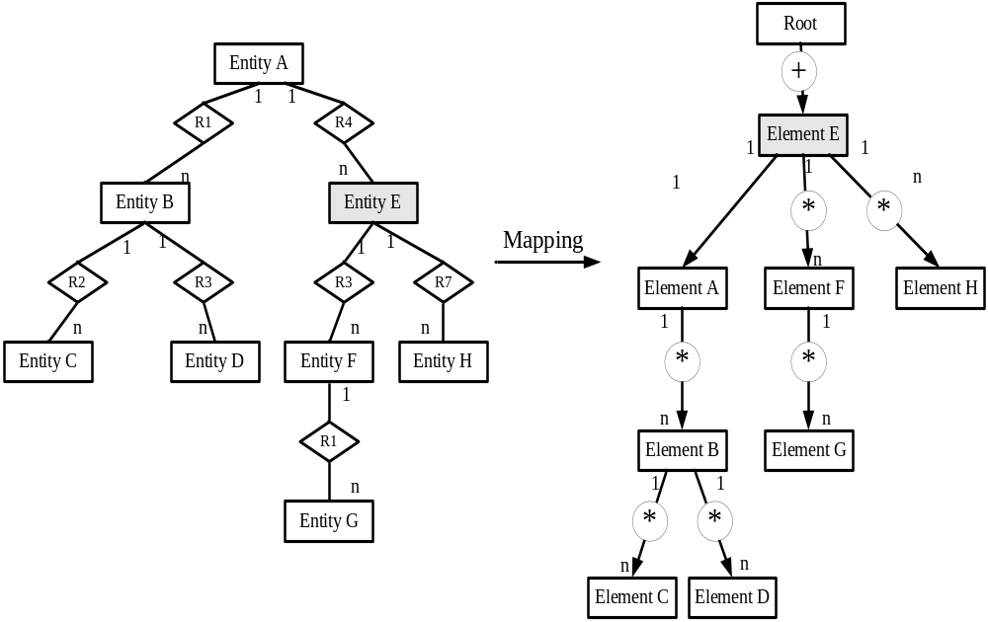
Extended Entity Relationship Model
DTD Graph
2008/1/9

Slide 33
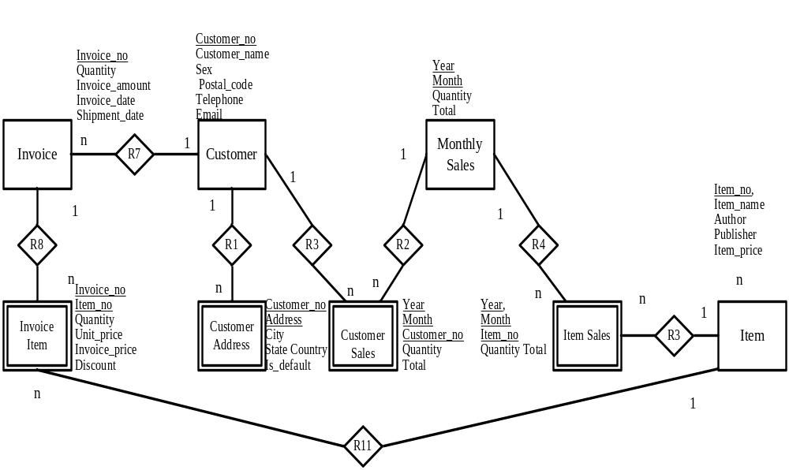
An EER model for Customer Sales
2008/1/9

Slide 34
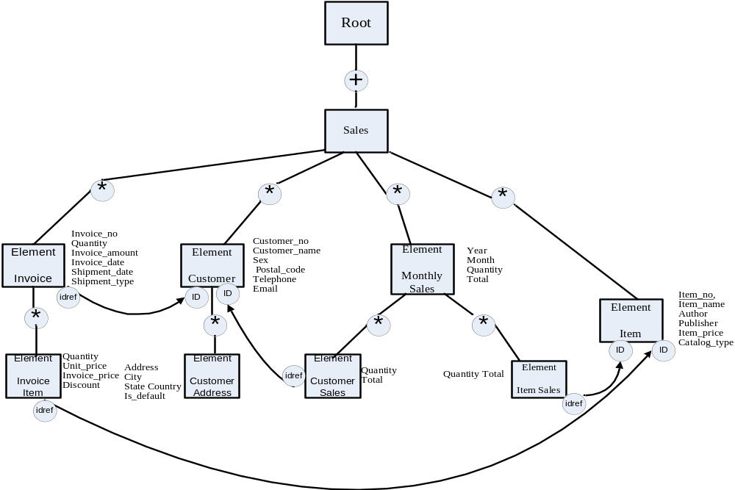
A Sample DTD graph for Customer Sales
2008/1/9

Slide 35
The mapped DTD from DTD Graph
<!ELEMENT Sales (Invoice*, Customer*, Item*, Monthly_sales*)>
<!ATTLIST Sales
Status (New | Updated | History) #required>
<!ELEMENT Invoice (Invoice_item*)>
<!ATTLIST Invoice
Invoice_no CDATA #REQUIRED
Quantity CDATA #REQUIRED
Invoice_amount CDATA #REQUIRED
Invoice_date CDATA #REQUIRED
Shipment_date CDATA #IMPLIED
Customer_idref IDREF #REQUIRED>
<!ELEMENT Customer (Customer_address*)>
<!ATTLIST Customer
Customer_id ID #REQUIRED
Customer_name CDATA #REQUIRED
Customer_no CDATA #REQUIRED
Sex CDATA #IMPLIED
Postal_code CDATA #IMPLIED
Telephone CDATA #IMPLIED
Email CDATA #IMPLIED>
<!ELEMENT Customer_address EMPTY>
<!ATTLIST Customer_address
Address_type (Home|Office) #REQUIRED
Address NMTOKENS #REQUIRED
City CDATA #IMPLIED
State CDATA #IMPLIED
Country CDATA #IMPLIED
Customer_idref IDREF #REQUIRED
Is_default (Y|N) “Y”>

Slide 36
<!ELEMENT Invoice_Item EMPTY>
<!ATTLIST Invoice_Item
Quantity CDATA #REQUIRED
Unit_price CDATA #REQUIRED
Invoice_price CDATA #REQUIRED
Discount CDATA #REQUIRED
Item_idref IDREF REQUIRED>
<!ELEMENT Item EMPTY>
<!ATTLIST Item
Item_id ID #REQUIRED
Item_name CDATA #REQUIRED
Author CDATA #IMPLIED
Publisher CDATA #IMPLIED
Item_price CDATA #REQUIRED>
<!ELEMENT Monthly_sales (Item_sales*, Customer_sales*)>
<!ATTLIST Monthly_sales
Year CDATA #REQUIRED
Month CDATA #REQUIRED
Quantity CDATA #REQUIRED
Total CDATA #REQUIRED>
<!ELEMENT Item_sales EMPTY>
<!ATTLIST Item_sales
Quantity CDATA #REQUIRED
Total CDATA #REQUIRED
Item_idref IDREF #REQUIRED>
<!ELEMENT Customer_sales EMPTY>
<!ATTLIST Customer_sales
Quantity CDATA #REQUIRED
Total CDATA #REQUIRED
Customer_idref IDREF #REQUIRED>
2008/1/9

Slide 37
Review Question 1
What are the similarity and dissimilarity between DTD and Well-formed Document?
2008/1/9

Slide 38
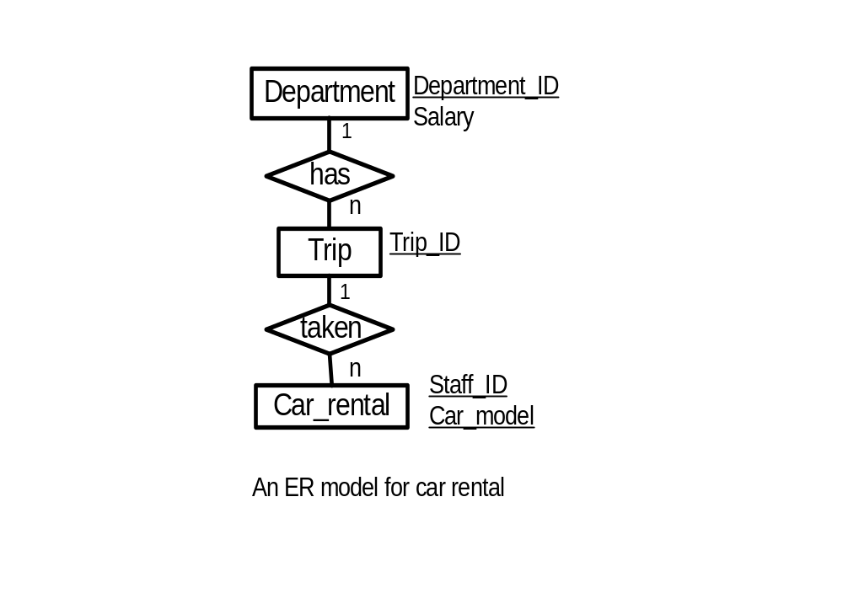
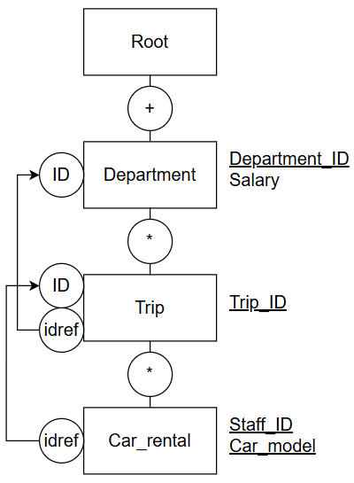
Tutorial question 1 (BTVN)
Map the following Extended Entity Relationship Model into an DTD Graph and a Document Type Definition (DTD)
DTD Graph (thực ra cũng không cần Root vì Department không có ngữ nghĩa nhiều):
Bỏ id, idref
Nếu vẽ Root thì nên để dấu * với Department
2008/1/9

Slide 39
DTD:
<!ELEMENT Department (Trip*)>
<!ATTLIST Department
Department_ID CDATA #REQUIRED
Salary CDATA #REQUIRED >
<!ELEMENT Trip (Car_rental*)>
<!ATTLIST Trip
Trip_ID CDATA #REQUIRED>
<!ELEMENT Car_rental EMPTY>
<!ATTLIST Car_rental
Staff_ID CDATA #REQUIRED
Car_model CDATA #REQUIRED>
2008/1/9

Slide 40
Reading assignment
Chapter 3 Schema Translation in “Information Systems Reengineering and Integration” Second Edition, by Joseph Fong, published by Springer, 2006, pp.142-154.
2008/1/9

